Slide 1
Class 1
Introduction to
Trade and Trade Policy
PubPol 201
Module 3: International Trade Policy

Slide 2
Class 1 Outline
Introduction to Trade and Trade Policy
Growth of world and US trade
The World Trade Organization (WTO)
Regional trade agreements
US trade policies and institutions
Recent events

Slide 3
Class 1 Outline
Overview of Trade and Trade Policy
Growth of world and US trade
The World Trade Organization (WTO)
Regional trade agreements
US trade policies and institutions

Slide 4
Growth of world and US trade
The world economy, GDP, has grown dramatically over time
World trade has grown even faster

Slide 5
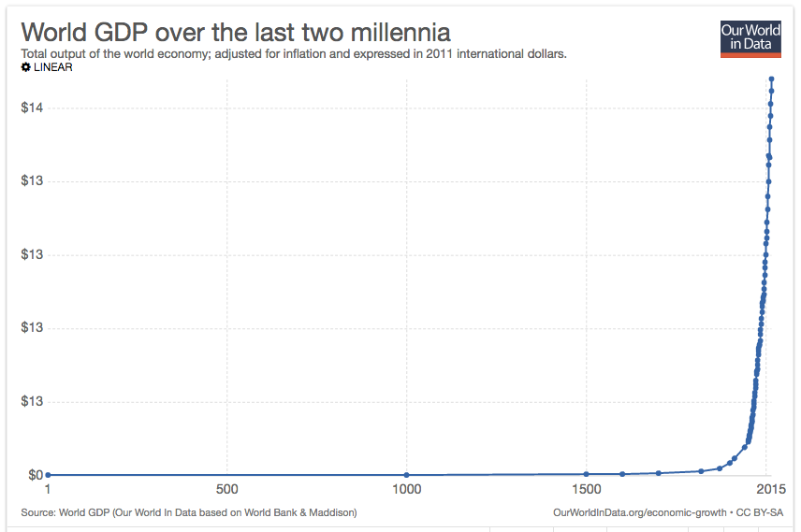
Notes:
https://ourworldindata.org/economic-growth

Slide 6
?

Slide 7
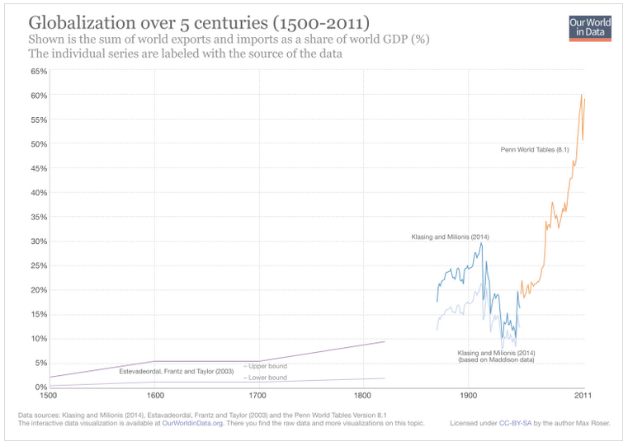
SecondGlobalization
First Globalization
Notes:
https://ourworldindata.org/international-trade

Slide 8
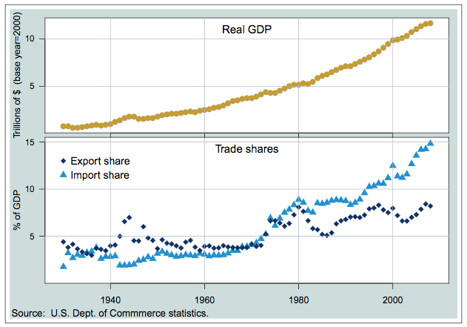
US GDP & Trade
Trade Deficit
Notes:
From USITC, US Trade Policy since 1934,

Slide 9
Discussion Question
Why has trade grown so fast?
  The next two slides will show just two reasons
  Your ideas?

Slide 10
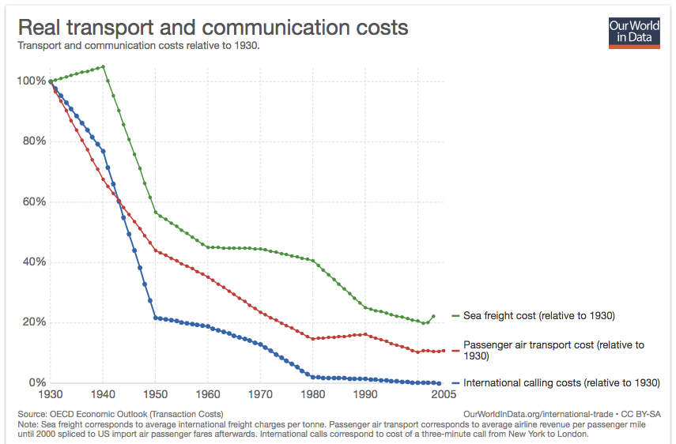
Notes:
https://ourworldindata.org/international-trade

Slide 11
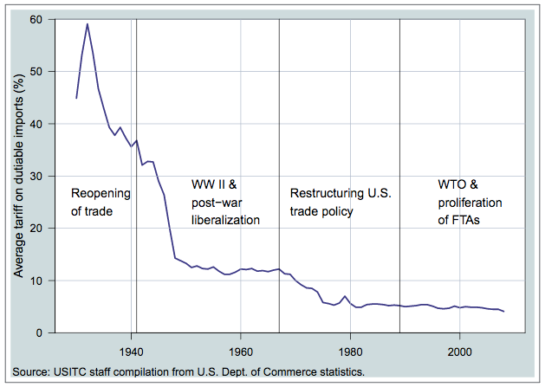
US Tariffs
Notes:
From USITC, US Trade Policy since 1934,

Slide 12
Class 1 Outline
Overview of Trade and Trade Policy
Growth of world and US trade
The World Trade Organization (WTO)
Regional trade agreements
US trade policies and institutions

Slide 13

World Trade Organization
WTO (and before it, the GATT)
  Rounds of multilateral tariff reductions
  Discipline on nontariff barriers
  Expanded coverage to include
    Services
    Intellectual Property
  Members
    GATT 1947: 23
    WTO now: 164

Slide 14
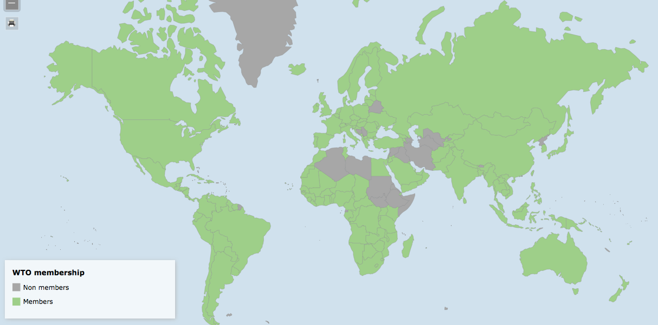
World Trade Organization
Interactive: https://www.wto.org/english/res_e/statis_e/statis_maps_e.htm

Slide 15
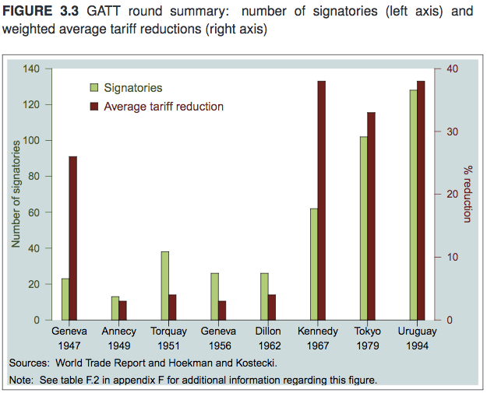

Slide 16
World Trade Organization
International Rule of Law
  GATT/WTO agreed rules for uses of trade policies
    Must not raise tariffs above levels that countries commit to
    Must not use certain other trade barriers
    Enforced through permitted retaliation

Slide 17
World Trade Organization
Rules do permit “trade remedies,” but constrain their use
  Safeguards tariffs
    Against imports causing injury
  Anti-dumping duties
    Against imports “unfairly priced”
  Countervailing duties
    Against subsidized imports
  (More on these below)

Slide 18
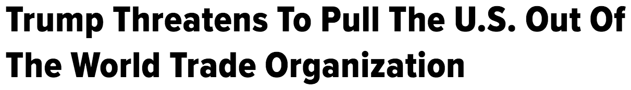

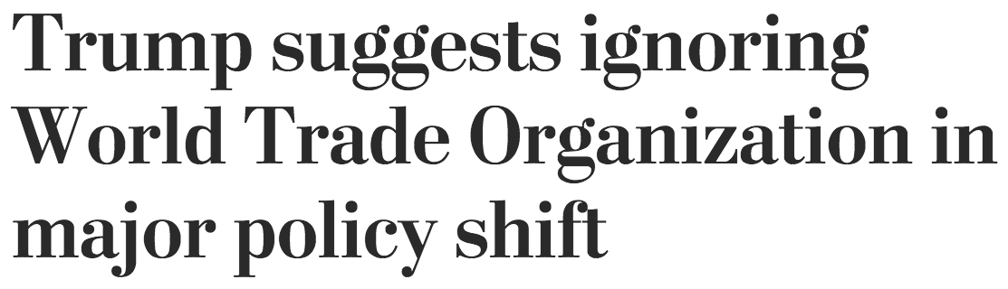

World Trade Organization
Donald Trump
  Has been critical of WTO
  Wants to ignore WTO
Jul 24, 2016
Mar 1, 2017

Slide 19
Discussion Question
What are your views, and what have you heard, pro and con, about the WTO?

Slide 20
Class 1 Outline
Overview of Trade and Trade Policy
Growth of world and US trade
The World Trade Organization (WTO)
Regional trade agreements
US trade policies and institutions

Slide 21
Regional trade agreements
Pairs or groups of countries that
  Eliminate most tariffs on imports from members
  Tariffs on outsiders?
    Leave unchanged and different
      FTA = Free Trade Area
      Example: NAFTA
    Adopt common external tariffs
      CU = Customs Union
      Example: European Union

Slide 22
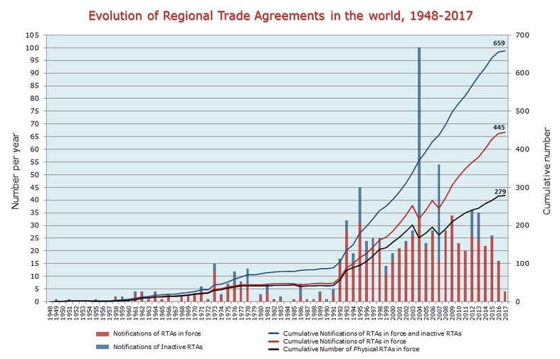
Notes:
https://www.wto.org/english/tratop_e/region_e/regfac_e.htm

Slide 23
US FTAs
Date | Agreement | Date | Agreement
1985 | US-Israel | 2006 | CAFTA-DR (US-Dominican Rep-Central America)
1989 | US-Canada | 2006 | US-Bahrain
1994 | NAFTA (US-Canada-Mexico) | 2009 | US-Peru
2001 | US-Jordan | 2009 | US-Oman
2004 | US-Singapore | 2012 | US-Colombia
2005 | US-Chile | 2012 | US-Panama
2005 | US-Australia | 2012 | US-South Korea
2006 | US-Morocco
Notes:
USTR

Slide 24
US FTAs
Donald Trump
  Pulled US out of TPP = Trans-Pacific Partnership
    FTA among US, Canada, Mexico, Japan, and 8 others (not including China)
  Threatened to pull out of NAFTA
    Has just renegotiated it
  US-Korea FTA
    Amended it, but in a way that reduces trade
Notes:
USTR

Slide 25
Discussion Question
What have you heard about NAFTA and other US FTAs?
We’ll be studying NAFTA during our last week of this module.
Notes:
USTR

Slide 26
Class 1 Outline
Overview of Trade and Trade Policy
Growth of world and US trade
The World Trade Organization (WTO)
Regional trade agreements
US trade policies and institutions

Slide 27
US Trade Policy
Who Is Responsible?
  Department of International Trade?
    No, we don’t have one
  US Constitution gives power to set import tariffs to Congress
    Congress has sometimes delegated that to the President
    See “Fast Track” below

Slide 28
US Trade Institutions
Responsibility for trade issues is spread over many entities
  Congress
  USTR = US Trade Representative
  Commerce Department
  US International Trade Commission
  Export-Import Bank
  and several others

Slide 29
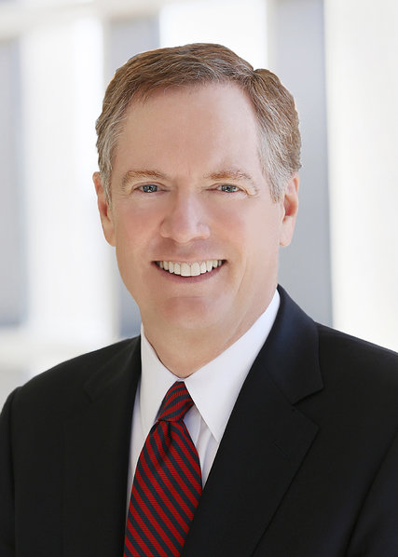
US Trade Institutions
Trump’s USTR is Robert Lighthizer
Cabinet-level official of US government
Role
  Handles negotiations on trade issues
  Drafts trade legislation for Congress

Slide 30
US Trade Institutions
Congress
  Sets tariffs and other trade policies (thus approves trade agreements)
  Two committees are responsible
    House: Ways and Means
    Senate: Finance
  Why these?
    Because trade policy was originally about collecting revenue

Slide 31
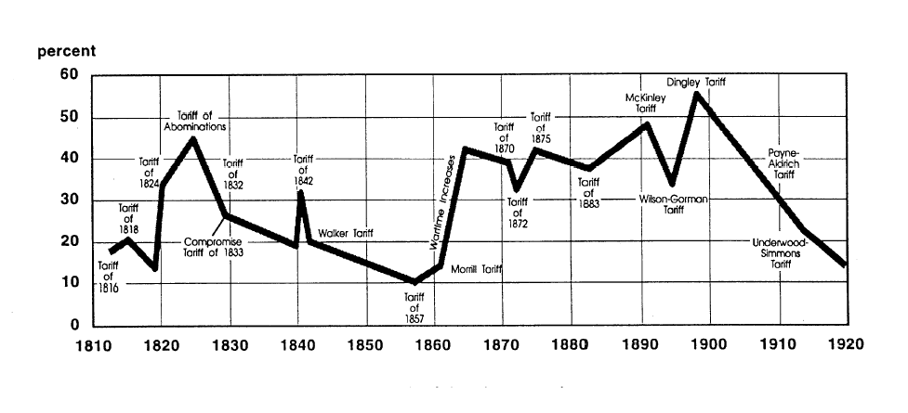
US tariff history: 1810-1920
Today
Notes:
Source: landandfreedom.org

Slide 32
US Trade Remedies
Escape Clause = Section 201 (Called “Safeguards” in WTO)
  Temporary protection from injurious imports
    Does NOT allege that the imports are “unfair”
  Eligibility is decided by USITC alone
    Injury (must be serious)
    Causation (must be due to imports)
  Tariff must be non-discriminatory
  Implemented by President, who may say NO.

Slide 33
US Trade Remedies
Unfair Trade Laws
  Permit protection (not temporary) from “unfair” imports
    Must also be injurious, but less than escape clause
    “Unfair” if
      “Dumped”, i.e., priced too low by firm
      Subsidized by foreign government
    Results:
      Anti-dumping duties (AD)
      Countervailing duties (CVD)
  President cannot say no

Slide 34
US Trade Remedies
Section 301
  Permits tariffs against countries that use “unfair trade practices”
  Vague. & illegal in GATT/WTO unless done through the WTO dispute settlement process
  Usage:
    Used in 1980’s against Japan
    Had not been used since WTO began in 1995
    Now being used by Trump against China for intellectual property theft

Slide 35
Other US Trade-Related Policies
Trade Adjustment Assistance
  Provides help to workers and firms displaced by trade (since 1962)
  Not very large or effective
“Fast Track” (=Trade Promotion Authority)
  Authorizes President to negotiate trade
  Congress commits to vote yes or no, but not change

Slide 36
Other US Trade-Related Policies
GSP = Generalized System of Preferences
  Lower tariffs for imports from least developed countries
  Permitted by GATT/WTO, and used by most developed countries

Slide 37
US Trade Policies
What motivates US trade policies? (See Baldwin)
  Political parties, but they changed:
  Presidents of both parties (until Trump) favored lower tariffs
    For foreign policy reasons (Cold War)
 | Democrats | Republicans
1930s | Lower tariffs | Protection
Today | Protection | Lower tariffs

Slide 38
Discussion Question
Do you view the United States as mainly a free trader, mainly protectionist, or somewhere in between?

